Slide 1
Web & Social Media Analytics Empowering a US Mobile Manufacturing firm to define their next product and marketing strategy. Amazon Reviews Analysis & Sentiment Insights PRESENTED BY Eshwar Ramesh and Mark Fernandes

Slide 2
Contents
Objective & Problem Statement
Data Sources & Methodology
Key Findings
Recommendations
Conclusions

Slide 3
Objective & Problem Statement
A mobile manufacturer based out of the US is looking to understand their competitors and preferences of their users to design their strategies accordingly
They want to tweak their marketing strategies and add more value to their brand
They also want to provide features to customers that add the most value
Their objective is to increase market share and brand value.

Slide 4
Data Sources & Methodology
Amazon mobile phone reviews dataset (~10,500 records)
Metadata: brand, price, rank, features
Text reviews pre-processed for NLP sentiment analysis
Tools: Python (EDA, NLP (Built a sentiment classification engine)), Tableau (visualization, dashboards)

Slide 5
Key Performance Indicators (KPIs)
Average rating: 4.2
Total reviews: 10,530
% Positive sentiment: ~75%
Verified reviews as proxy for genuine customer feedback

Slide 6
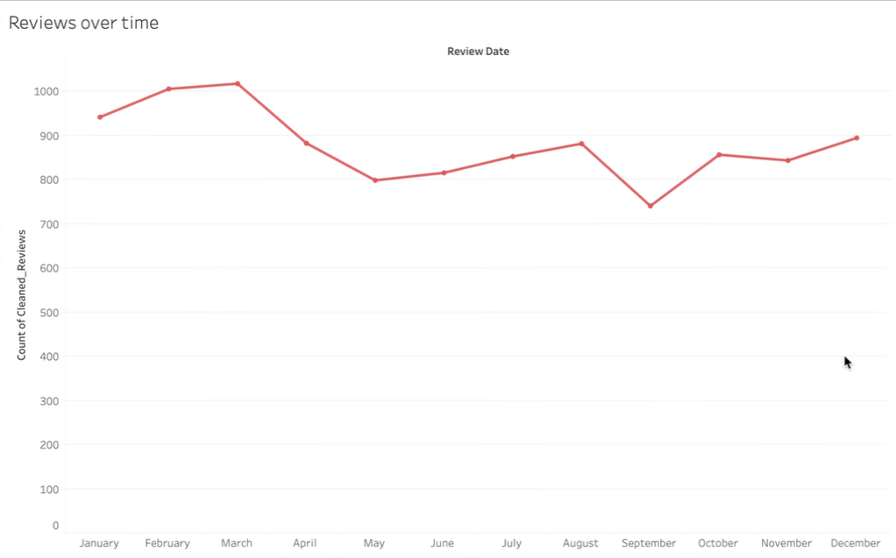
Reviews Over Time
Seasonal peaks during festive sales and launches
Baseline steady engagement otherwise
Opportunity: plan product launches and promotions around spikes

Slide 7
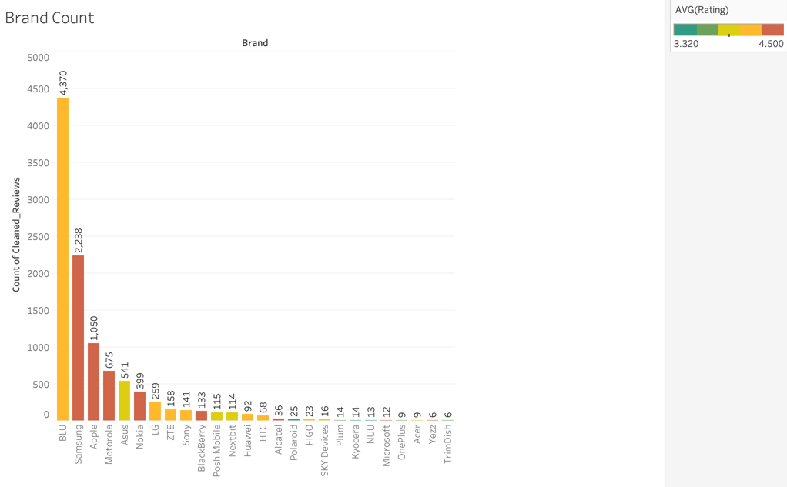
Brand Count (Market Share Proxy)
BLU, Samsung, Apple dominate review volumes
High volume ≈ strong market presence
Smaller brands show low penetration but may target niches

Slide 8
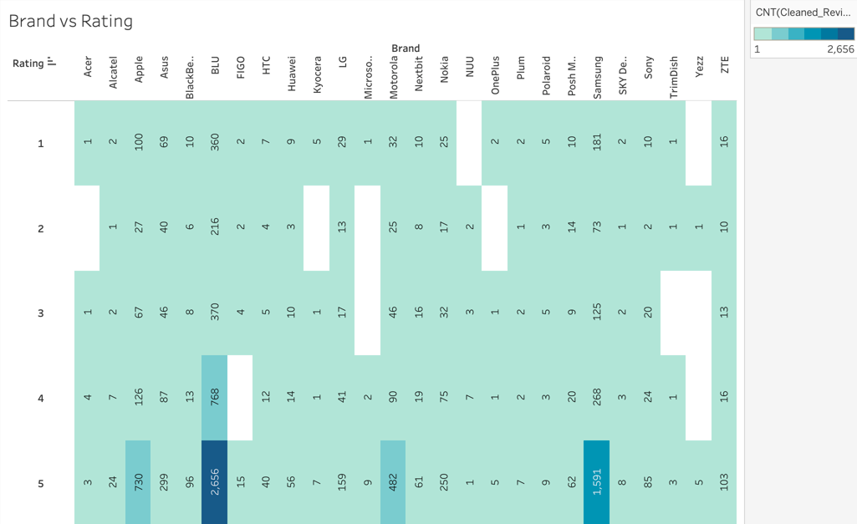
Brand vs Rating (Quality Perception)
Apple, Samsung → consistently high 4–5 star ratings
BLU & Motorola → large variance, inconsistent quality
Benchmark: replicate Apple’s consistency

Slide 9
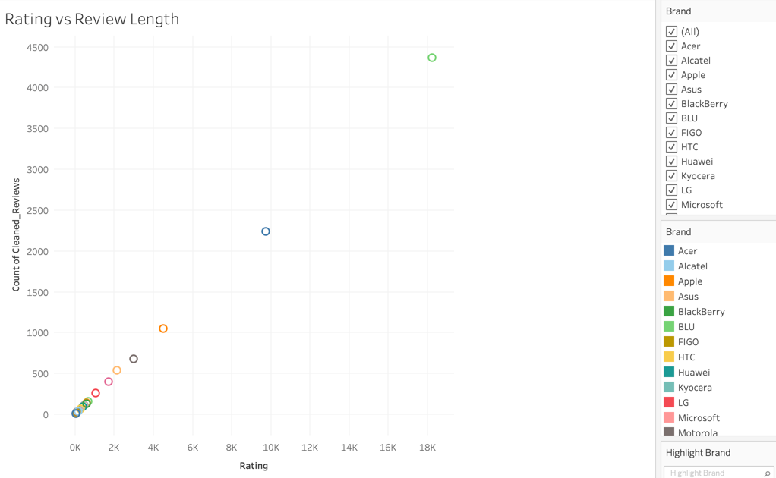
Rating vs Review Length (Detail Insights)
Long reviews = strong positive/negative emotions
Positive long reviews emphasize camera, screen, performance
Negative reviews emphasize battery, service, durability

Slide 10
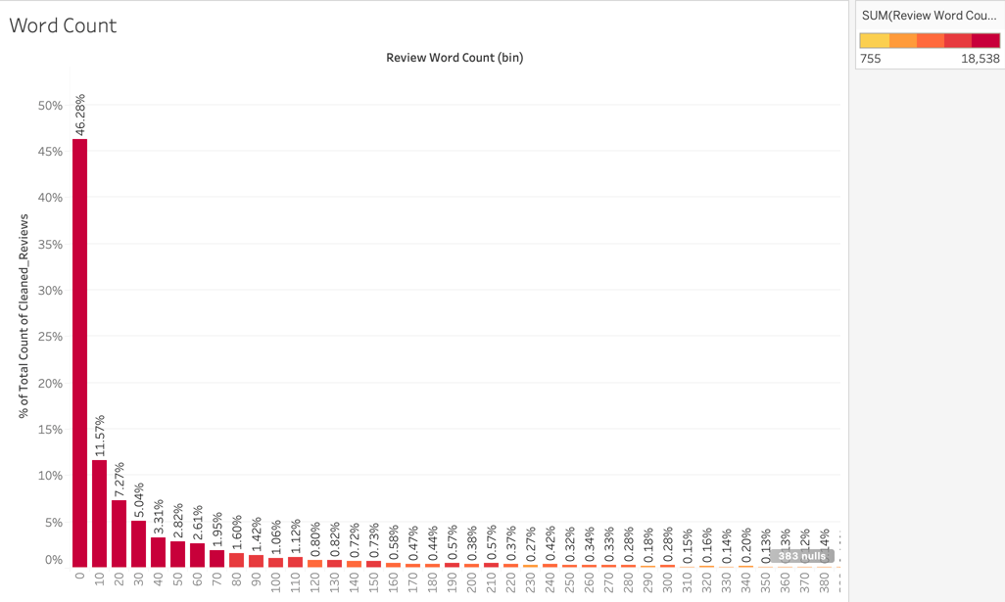
Word Count Distribution
Majority reviews short (<20 words) → limited insights
Long reviews valuable for feature-level feedback
NLP was used to mine these for specs/strengths/weaknesses

Slide 11
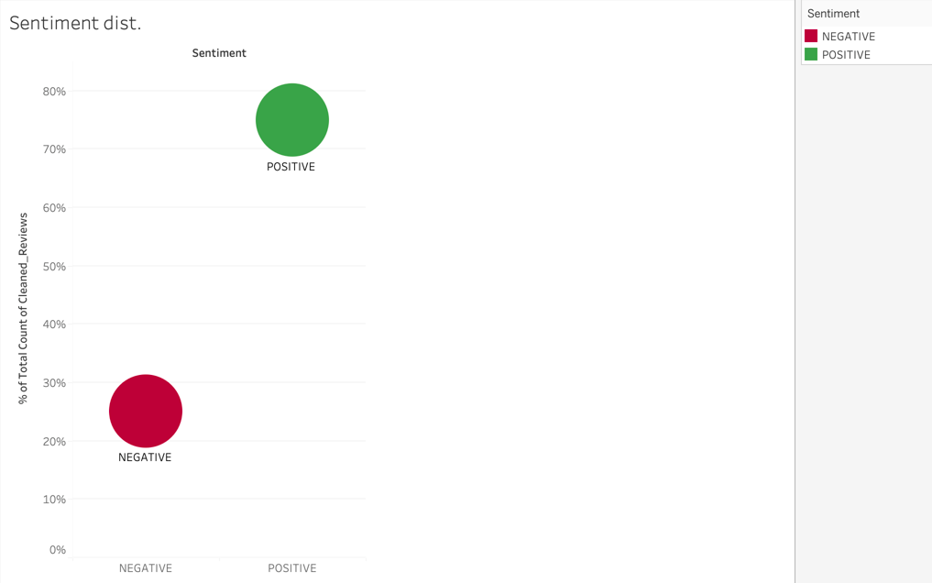
Sentiment Distribution
~75% Positive vs ~25% Negative
Positive skew shows brand trust
Negative feedback significant enough to guide product improvements

Slide 12
NLP Sentiment Analysis (Naive Bayes Model)
Pre-processing: stop words removed, lemmatization, TF-IDF features
Classifier: Multinomial Naive Bayes
Model accuracy ~85–87% on test data
Confusion matrix shows strong detection of positive reviews, moderate false negatives
Implication: reliable real-time monitoring tool

Slide 13
Customer Preferred Specs (from NLP + metadata)
Insights from Dataset (Amazon Reviews up to 2018)
Camera: customers mention positively when ≥ 12–16 MP; negative when < 8 MP
Screen: sweet spot is 5.0–5.5 inches (praised for balance of usability + viewing)
Battery: 3000 mAh or higher favored; < 2500 mAh often linked to complaints
Price sensitivity: mid-range segment ($200–400) receives most positive mentions
Performance: RAM ≥ 3 GB and storage ≥ 32 GB often cited in positive reviews
Market Context (2025 Benchmark)
48 MP+ multi-lens cameras are now standard in mid/flagship models
Screens shifted upward to 6.1–6.7 inches (compact vs big-screen flagships)
4500 mAh+ batteries are the new baseline for competitive smartphones
Minimum expectation: 6–8 GB RAM, 64 GB+ storage in mid-range devices

Slide 14
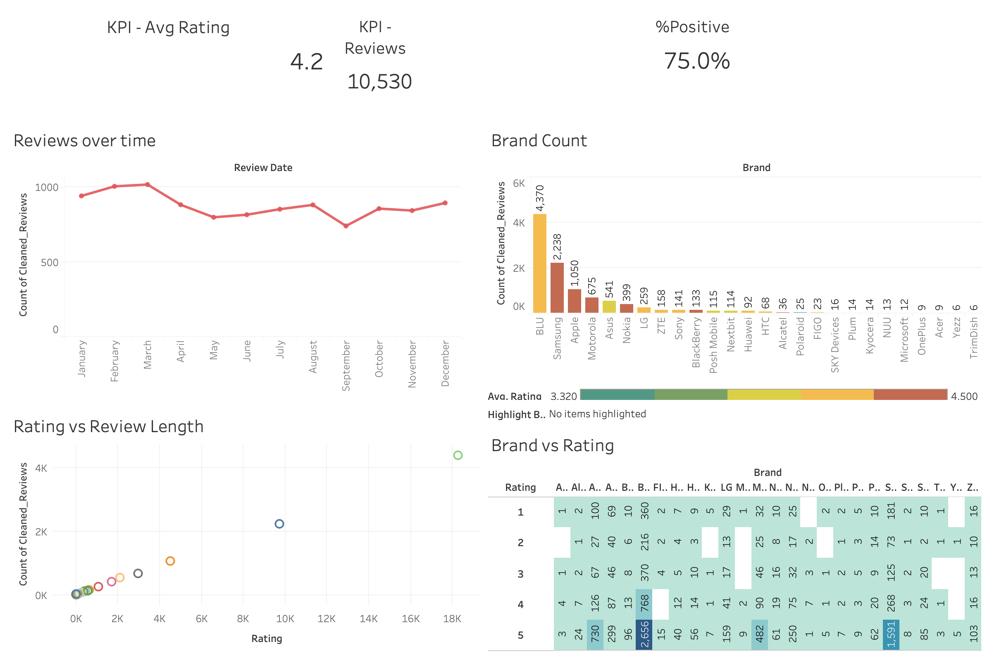
Final Dashboard of Visualisations

Slide 15
Recommendations
Insights from Dataset (Amazon Reviews up to 2018)
Product: prioritize battery life, durability; keep camera ≥ 16 MP, screen around 5–5.5 in, performance ≥ 3 GB RAM
Marketing: leverage seasonal spikes; highlight camera/screen in campaigns; use testimonials from verified reviews
Operations: track sentiment in real-time; respond quickly to negatives; monitor niche competitors
Market Context (2025 Benchmark)
Launch products with 48 MP+ cameras, 6.1–6.7 inch displays, and ≥4500 mAh batteries
Position devices with 6–8 GB RAM and 64 GB+ storage in the $200–400 segment

Slide 16
Conclusion
Company can improve market share by aligning specs with consumer expectations
Leverage NLP insights to guide product design + marketing
Data-driven approach ensures sustainable growth

Slide 17
Thank You

